Slide 1

Selection of POGO-Pin based Umbilical Connectors for ESA COMET-Interceptor Mission
Florian MOLIERE, Gilles Roland BEAUFILS
SPCD2024 Conference, ESTEC
03/10/2024

Slide 2
Summary
1) COMET-Interceptor ESA Mission
2) ISM Connectors Characteristics and selection
3) Connector modifications for COMET-I ISM
4) Connector qualification
5) Qualification timelines and FM delivery
6) Conclusions
7) References
8) Annexes

Slide 3
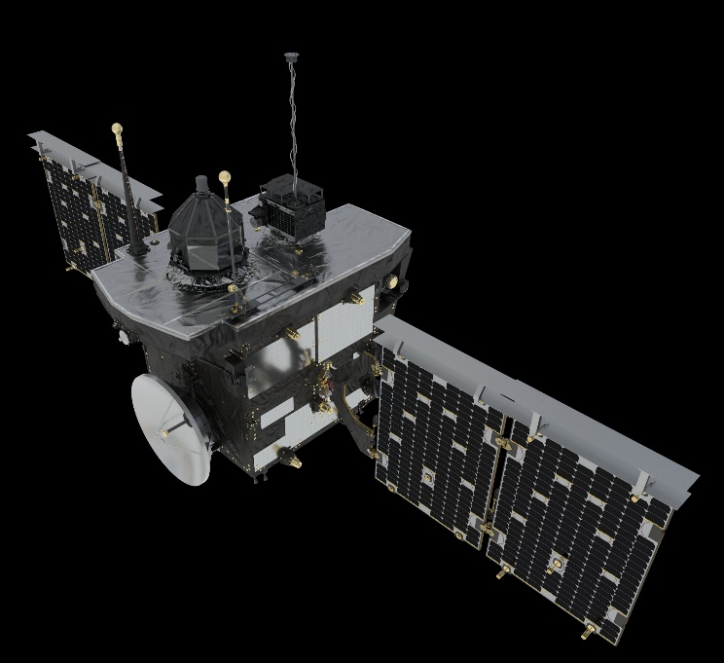
1) COMET-Interceptor ESA Mission
ESA Program: Science, Class F mission = Fast track, extremely compressed schedule (QAR 2029)
Objective: Fly by a comet which is visiting the inner Solar System for the first time,
or if opportunity: an interstellar object
Configuration: 3 elements, 1 Main Spacecraft (A) [ESA] + Probe B1 [JAXA] + Probe B2 [ESA]
Probes are separated about 30h before encounter
Mission Profile : Total duration 6 years,
typically: 3-4 years waiting
for target opportunity in L2,
3-2 years transfer,
fly-by, 6 months downlink.
QA Frame: ESCC Q60 Class 3
Probe B2 (ESA)
Probe B1 (JAXA)
Main Spacecraft A

Slide 4
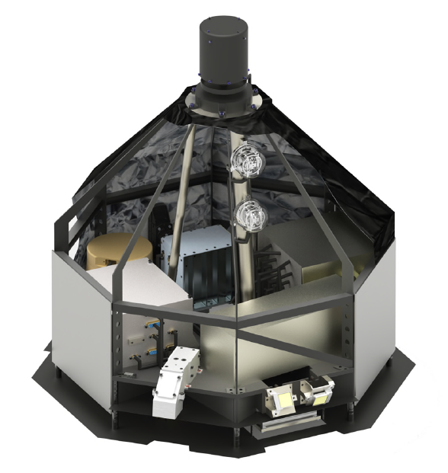
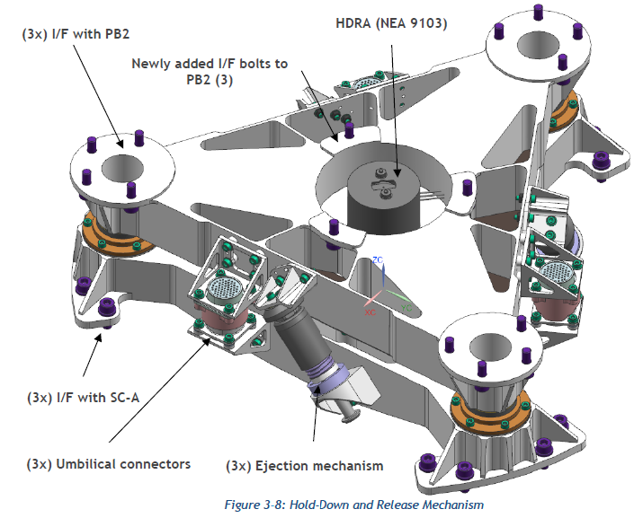
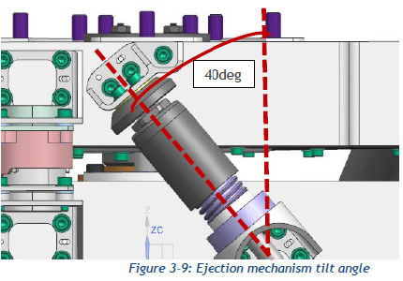
1) COMET-I Mission and Connector Characteristics
Scope of discussion: Inter-satellite Separation Mechanism ISM for Probe B2 (ESA)
Spacecraft A: ~ 1 ton, 2.5 x 2.2 x 2.0 m (stowed configuration)
Spacecaft A Prime: OHB (I)
Probe B2 size: About 40Kg, about 0.5 x 0.5 x 0.5 m
Probe B2 Release: Spin Eject Mechanism
Probe B2 Prime: SENER (E)
ISM contractor: SENER (PL)
Electrical link: 3 separable connectors
Connector Baseline: Zero/Negative Separation Force
Custom based on POGO Pins
Probe B2 (ESA)
ISM Mechanism

Slide 5
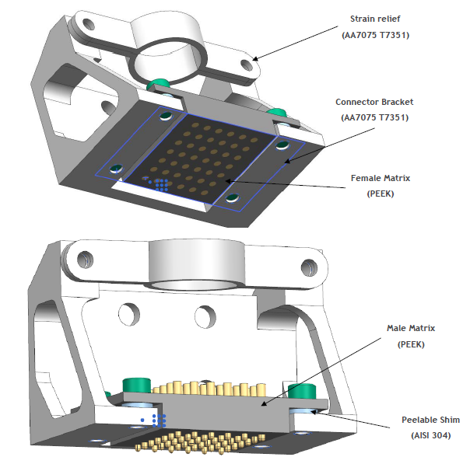
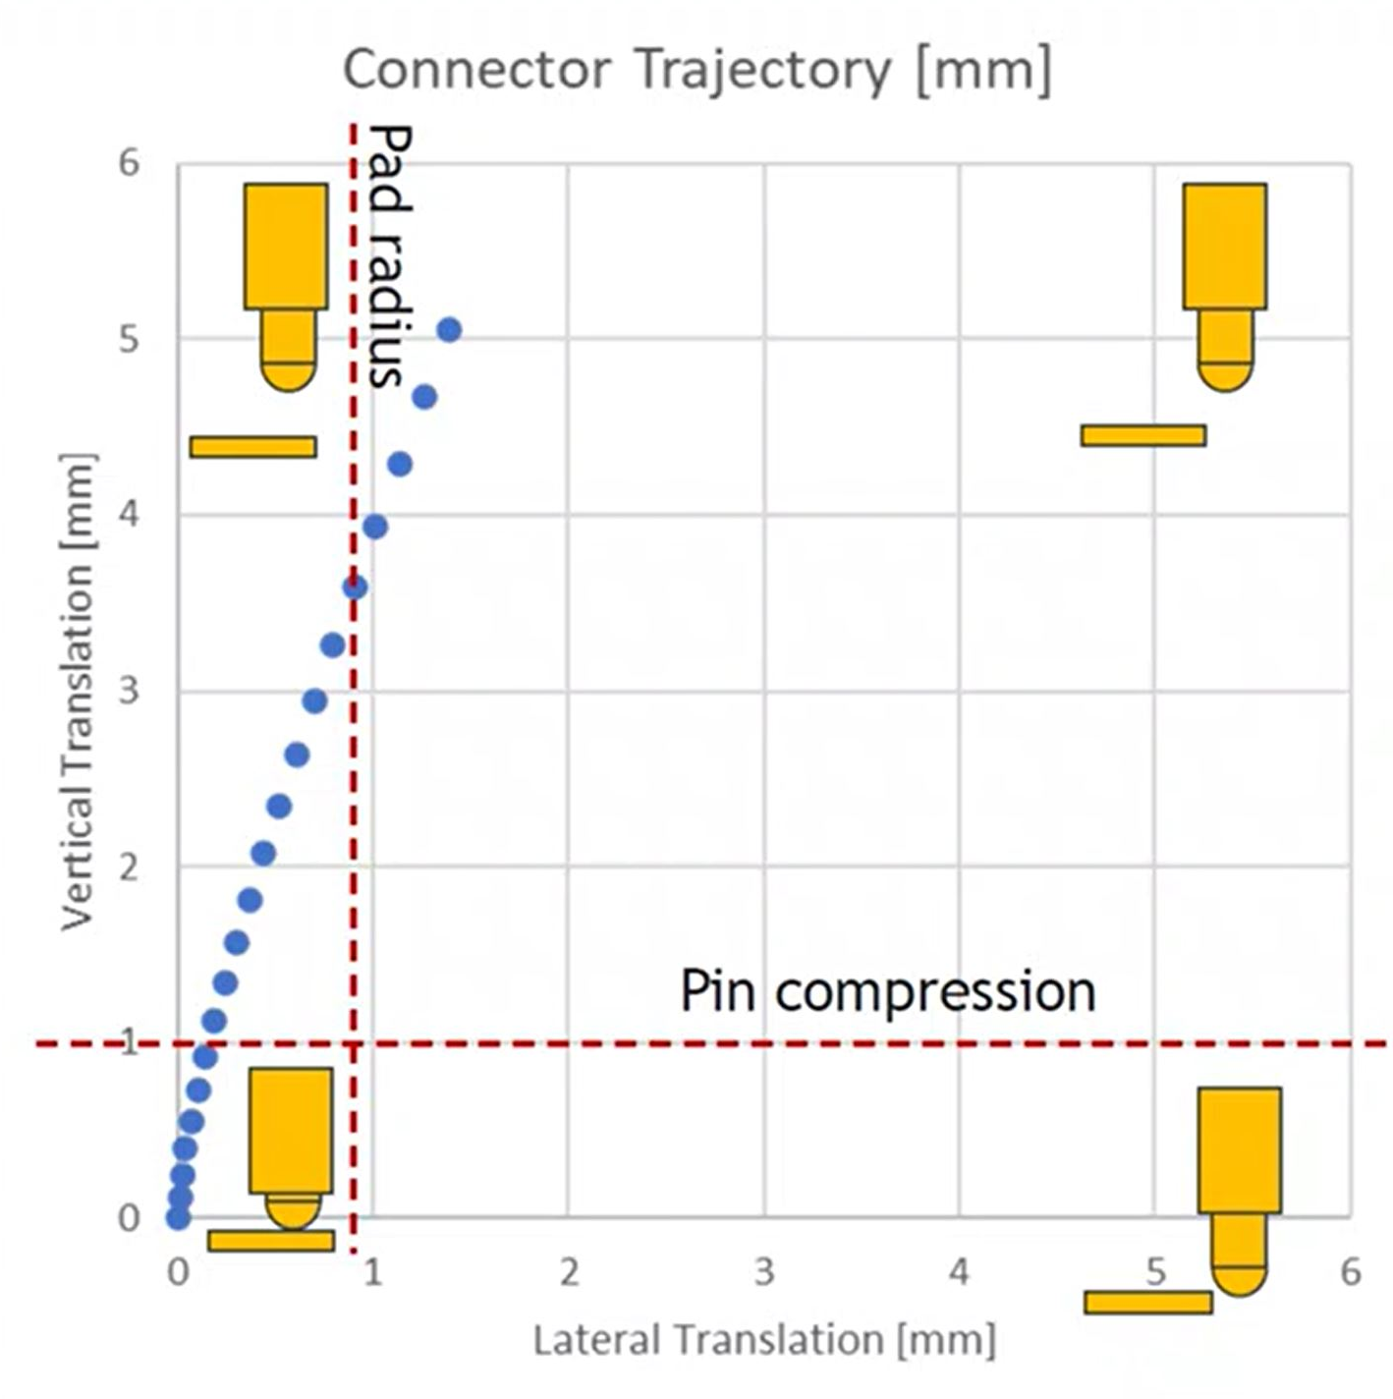
2) ISM Connectors Characteristics and selection
Umbilical Connector: Initial Solution
Issue with respect to existing solution:
Spin Eject imply a lateral / torsion movement at separation
→ Solutions with long guidance sleeves lead to perturbations
Compliance needed for position tolerance / complex movement
→ Solutions with connector level articulation have high mass
Custom Umbilical Connector solution (SENER proposition)
No Sleeve at all
→ Engagement limited to pin compression (1mm)
→ Large flat pad on cup side to allow position tolerance and
some lateral sliding during separation.
→ Pins hard cemented in insulation block for rigidly
(with related issues and qualification challenge)

Slide 6
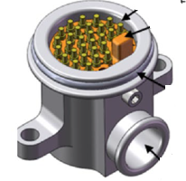
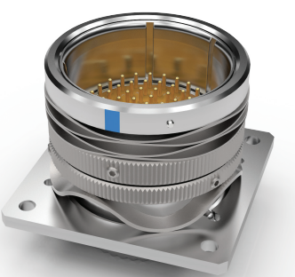
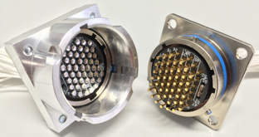
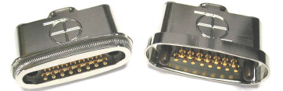
2) ISM Connectors Characteristics and selection
Criteria |  | Initial solution | Alternative#1 JAXA Connector | Alternative#2 PSC Connector | Alternative#3 EBAD Connector | Alternative#4 DLR Connector
Connector | Connector Shell | Custom Mechanical assembly | ALB Custom | 4000106C/4000107C COTS | ZSF100P MIL-DTL-38999 | MIL-DTL-38999 circular connector
 | Pin | Spring Pin | Spring Pin | Spring Pin | MIL-C-39029 pin and socket contact | Spring Pin
 | Nb of Pin (>40) | 42 | 30 | 15 | 62 (Shell Size 25) | 55
 | Zero/Negative Separation Force | Negative | Negative | Negative | 0 N (Zero) | Negative
 | Spin separation compatibility | To be demonstrated | YES with adaptation | NO | YES with adaptation | YES with adaptation
Solution considered for COMET-I ISM
Quality | Quality grade | Custom + upscreening | Custom + upscreening | COTS + upscreening | Military | Military + upscreening wrto mission
 | Space Mission Heritage | NO | NO COMET-I Probe B1 (not yet launch) | CubeSAT | MSR Sample transfer Arm (not yet launch) Space Launch System SLS & Orion | YES (ESA Class 1) Philae and MASCOT TRL9 + Qualified for MMX Rover TRL8 and Gossamer-1 TRL7
 | Cold Welding Management | Custom | NO | NO | NO | YES (Pt coating)
 | Temperature range | unclear | unclear | -30/+111C | -55/+200C | -90/+115C
Procurement | Availability | YES to be developed | unclear | YES | YES | YES
 | Schedule Development/qualification | High | unclear | Short | Short | Medium
 | Technical support | YES | YES | NO | NO | YES
 | Cost | … | … | … | … | …

Slide 7

2) ISM Connectors Characteristics and selection
EVALUATION EXTRACT:
Mechanical Stress compatibility with respects to COMET-I environnemental requirements
Test | COMET-I ISM mechanical requirements | MASCOT UMC tested levels | MMX Rover system-level test input levels | Gossamer-1 launcher input levels & amplification factors | Assessment for COMET-I ISM
Quasi Static Load | QSL: 22.5g | Fully covering | Not covering | TBC | OK
Sinus Vibration |  | Partially covering 22-100Hz | Partially covering 25-100Hz | Not covering | 5-22Hz 20g to be evaluated But no blocking
Random Vibration |  | Partially covering | Partially covering 2000Hz | Fully covering | OK
Mechanical Shock |  | Partially covering 100-2000Hz | Partially covering 100-3000Hz | Fully covering | OK
Thermal Vacuum | -40…+52°C ops -45…+70°C non-ops | Fully covering | Fully covering | Not covering | OK

Slide 8
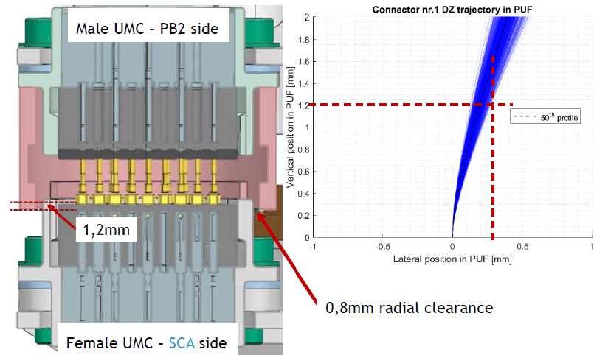
3) Connector modifications for COMET-I ISM
1) ISM modification: customized guide shell
Goal:
To prevent contact between a Pad and a Pin of not the same pair during PB2 separation form the SpacecraftA
Modification:
The guide was modified (shorten) in such a way it allows a separation of the mechanism while installed vertically and maintains its functionality:
Mechanical protection of pins
Hard end-stop disallowing damaging the pins due to higher compression
Angular alignment of the connector counterparts
Lateral tolerance of 0.8 mm for a Z-disengagement of 1.2mm
Hard end-stop
Angular Reference
1.2 mm
0.3 mm

Slide 9
4) Connector qualification
UMC/Cable assembly Production Control Tests
ISM Qualification
Qualification Philosophy
No dedicated ESCC3401 Chart III Screening and Chart IV qualification
DLR qualification for past mission compatible with COMET-I environmental and mechanical requirements
Umbilical Connector UMC and cable assembly production controls by DLR/JOWO
Qualification at ISM level by SENER
Material Reception, DP review
ISM Quasi-static Loads
Serialisation, UMC assembly
ISM Sine Loads
Contact Inspection
ISM Random Loads
Mating Force test
ISM Shock Loads
UMC Electrical measurement
Cable Assembly Shipment and integration to ISM
ISM Shock Loads
Cable assembly
ISM operational qualification temperature
Cable assembly Electrical Measurement
ISM non operational qualification temperature
Temperature cycling
ISM Qualification Acceptance review
Cable assembly Electrical Measurement
Mating Force test
JOWO
Cable assembly External Visual Inspection
DLR
Cable assembly acceptance Review
SENER

Slide 10
5) Qualification timelines and FM delivery
Schedule:
 | QM Delivery | FM Delivery
Umbilical connectors | No QM | February 2025
ISM | November 2024 | Q4 2025
COMET-I | NA | Mid-2028 (QAR)

Slide 11
6) Conclusions
Presentation:
Selection of POGO-Pin based Umbilical connector for ESA COMET-Interceptor Mission
COMET-I mission has been introduced (ECSS-Q-ST-60C EEE Class 3)
Selection process of POGO pin based solution for ISM umbilical connectors
Hardware modification: GUIDE to allow the separation of the mechanism PB2/Spacecraft
No dedicated ESCC3401 Chart III Screening and Chart IV qualification
  Custom Cable assembly production control and qualification wrt mission at ISM level
  Derisking demonstrated for COMET-I needs
  Trade off Mission EEE quality requirement - schedule
Great collaboration between teams DLR/JOWO, SENER, OHB-I and ESA COMET-I teams

Slide 12
6) Conclusions
We acknowledge the support of:
ESA COMET-I Team
OHB-I COMET-I Team
SENER Spain
SENER Poland
DLR
JOWO Systemtechnik AG
Thanks for your Attention

Slide 13
7) References
[1] | Christian D. Grimm and Al, The MASCOT Separation mechanism, A reliable, low-mass deployment system for nano-spacecraft, CEAS Space Journal (2020) 12:343–365
[2] | Datasheet EBAD, NEA_Zero_Separation_Force__ZS__and_In-Flight_Disconnect__IFD__released__4-12-22
[3] | Datasheet 4000106C connector, PSC, https://www.rocketlabusa.com/assets/Uploads/2001025D-Separation-Connector-Data-Sheet.pdf

Slide 14
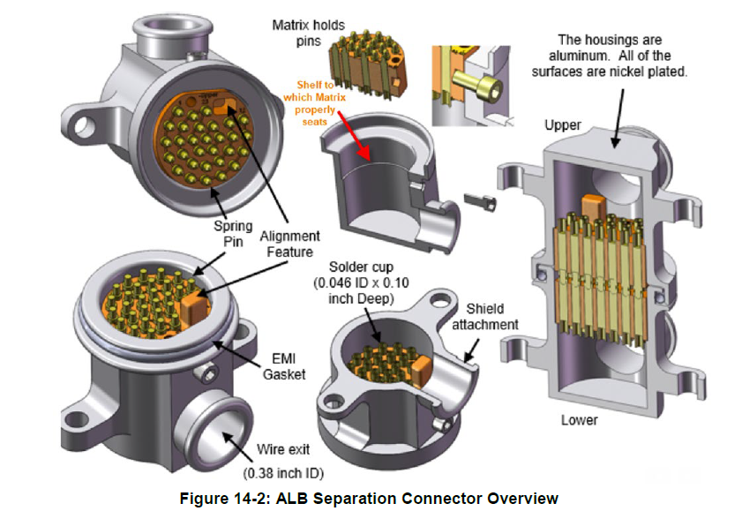
8) ANNEX
Potential Alternative #1:
Manufacturer: Rocketlabusa
Quality grade: Custom Qualification
Availability: To ask Rocketlabusa
Heritage /Mission: Probe B1-Spacecraft (JAXA)

Slide 15
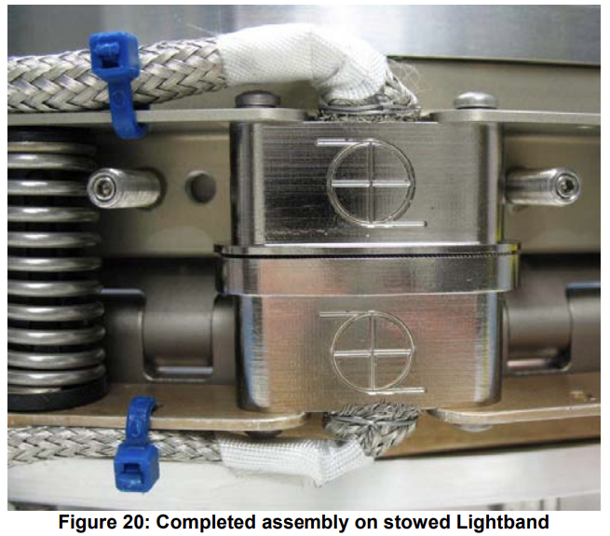
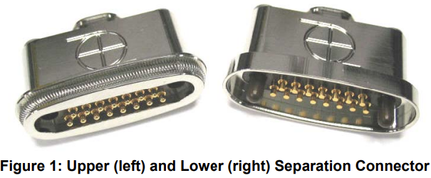
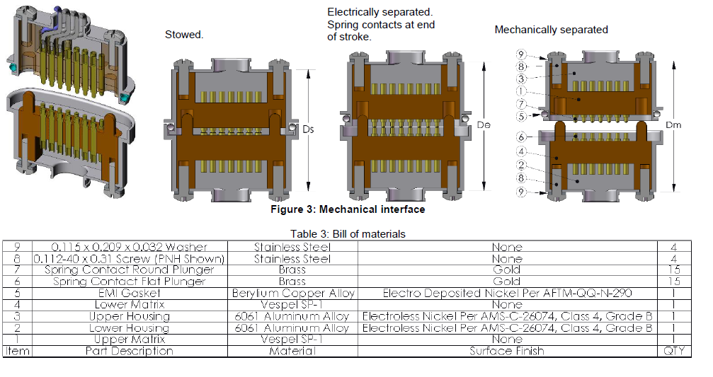
8) ANNEX
Potential Alternative #2:
4000106C Lower Separation Connector
4000107C Upper Separation Connector
Manufacturer: RocketLab (formerly Planetary System Corporation (PSC)
Quality grade: COTS
Availability: YES
Heritage /Mission: CubeSAT, unknown
[3]
[3]
[3]

Slide 16
8) ANNEX
Potential Alternative #3:
EBAD Zero Separation Force & In Flight Disconnect
ZSF100P Size 25 -25-61 type, 61 pins/sockets, #20 size + ZSF202S
Manufacturer: Ensign-Bickford Aerospace & Defense Company (EBAD)
Quality grade: Military MIL-DTL-38999 inserts and MIL-C-39029 pin and socket contacts
Availability: YES
Heritage /Mission: Unknown (Satellite, spacecraft and payload)
[2]
[2]

Slide 17
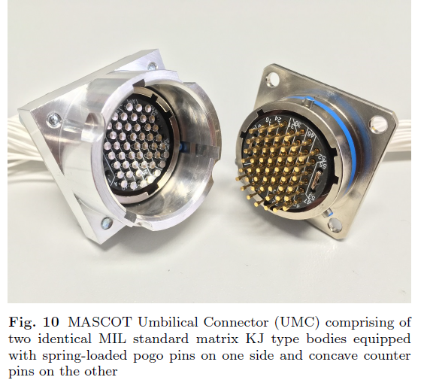
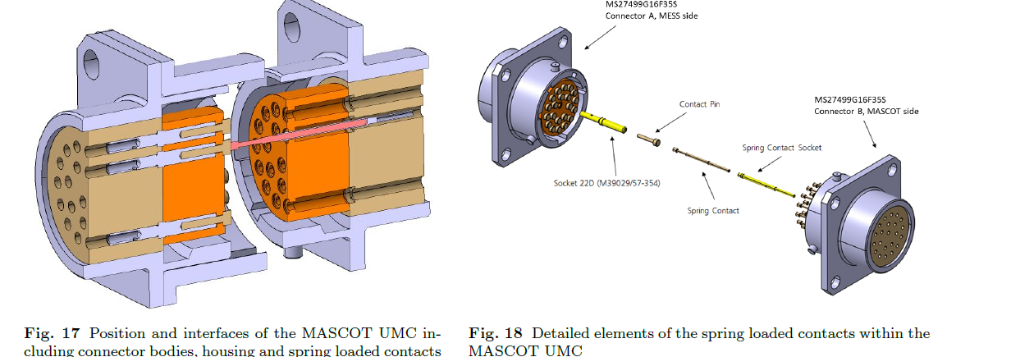
8) ANNEX
Potential Alternative #4:
Manufacturer: Custom solution
DLR - JOWO Systemtechnik AG
Quality grade: Military + custom upscreening
Availability: YES
Heritage /Mission:
Rosetta/Philae (2004), MASCOT (Launch 2014)
Qualified for Martian Moons Exploration MMX (2026)
[1]
[1]
[1]

